Slide 1


IDS 1721
Computing and Problem Solving for STEM
Midterm 3 Review

Slide 2
Format
10 questions total
Six Multiple Choice questions
“Analyze the following code” question
Three Free-Response (“Hand-written Coding”) questions

Slide 3
General topics
Chapter 4
  Arrays
  Plotting
  MATLAB functions such as linspace
Chapter 5
  Functions
  Functions that call Subfunctions
Cumulative aspects of the previous chapters that Chapter 4 and Chapter 5 depend on and use

Slide 4
What to study:
Lectures
  Especially Slides L14 through L20 and L22(today’s)
    Note: Our L16 slides are really a first-draft for L17 and L18
In Class Assignments
Homework
  Homework 6, 7, and 8
    7 is due Monday, Nov. 18th
    8 is due Dec. 2, but available now

Slide 5
Chapter 4: Arrays, Quick Practice 1
On the command line . . .
. . . make a row vector called vrow. . .
. . . that has five elements, . . .
. . . starting from 1, . . .
. . .ending at 5, . . .
spaced by 1

Slide 6
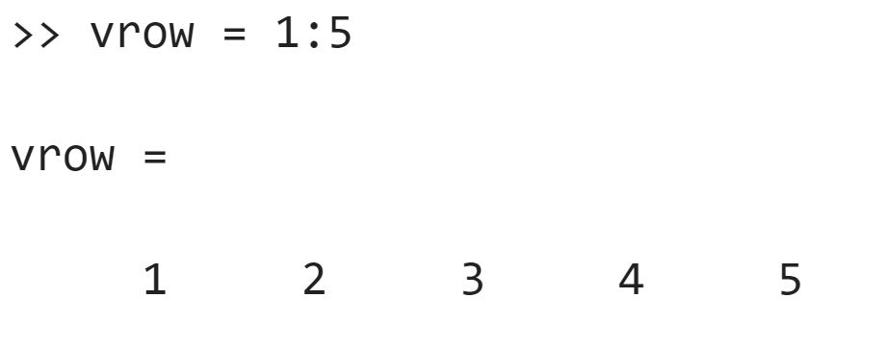
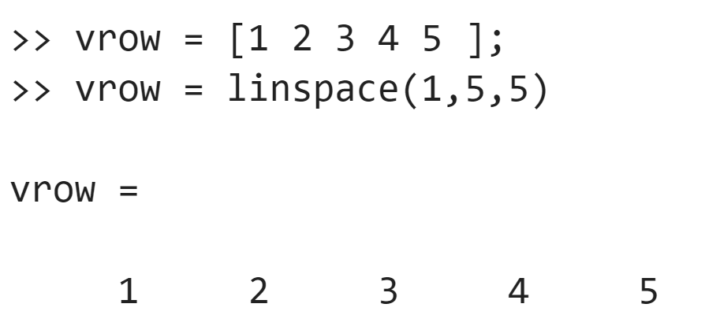
Colon operator
“By hand”
Using the linspace function

Slide 7
Chapter 4: Arrays, Quick Practice 2
On the command line . . .
. . . make a column vector called vcol. . .
. . . that has five elements, . . .
. . . starting from 1, . . .
. . . ending at 5, . . .
spaced by 1

Slide 8
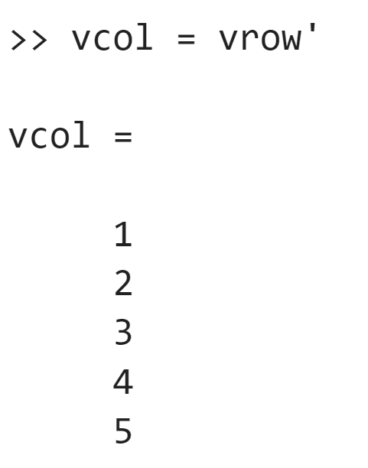
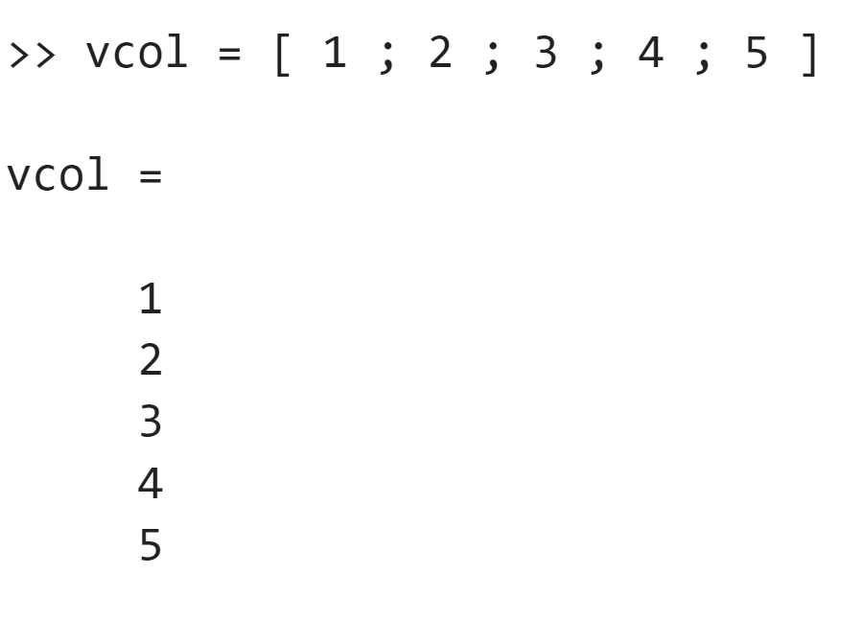
Using the “transpose”
command
By hand, with semi-colons

Slide 9
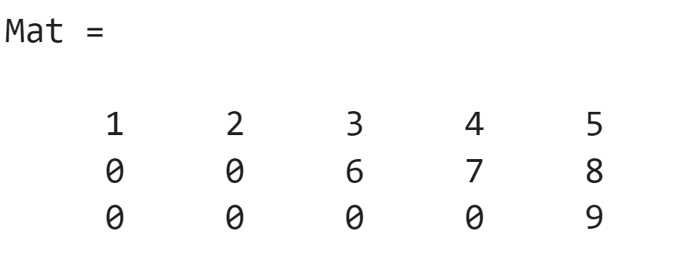
Chapter 4: Arrays, Quick Practice 3
On the command line . . .
. . . make a matrix named Mat . . .
. . . that looks like the following:

Slide 10
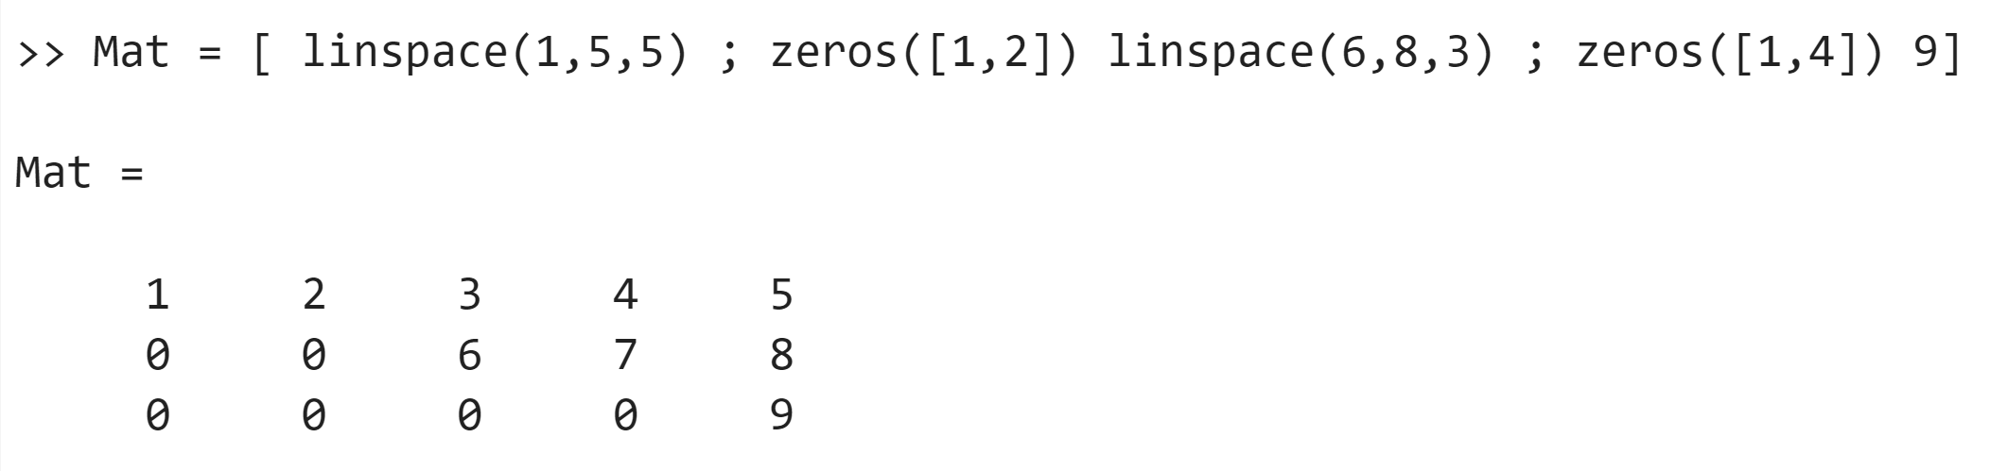
By hand
By concatenating arrays made with linspace and zeros
1 row, 2 columns
1 row, 4 columns

Slide 11
Chapter 4: Arrays, Quick Practice 4
On the command line . . .
. . . make a row vector named rlin . . .
. . . by calling the linspace function . . .
. . . with a minimum value of 0, . . .
. . . a maximum value of 6π,
. . . and 100 elements.
Then, DISPLAY the FIRST entry (should be 0),
DISPLAY the LAST entry is (should be 6π),
DISPLAY the number of elements (should be 100)

Slide 12
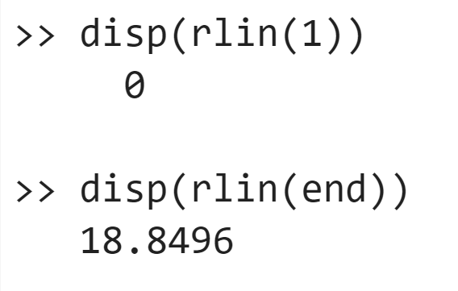
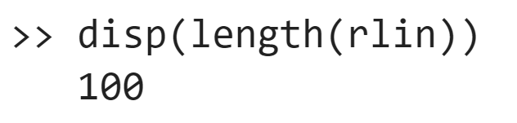

Slide 13
Chapter 4: Arrays, Quick Practice 5
On the command line . . .
. . . make a row vector named rspace . . .
. . . by using the “:” operators . . .
. . . with a minimum value of 0, . . .
. . . a maximum value of (up to) 6π,
. . . and a spacing of 0.02.
Then, DISPLAY the value of the FIRST entry
DISPLAY the value of the LAST entry
DISPLAY the number of elements

Slide 14
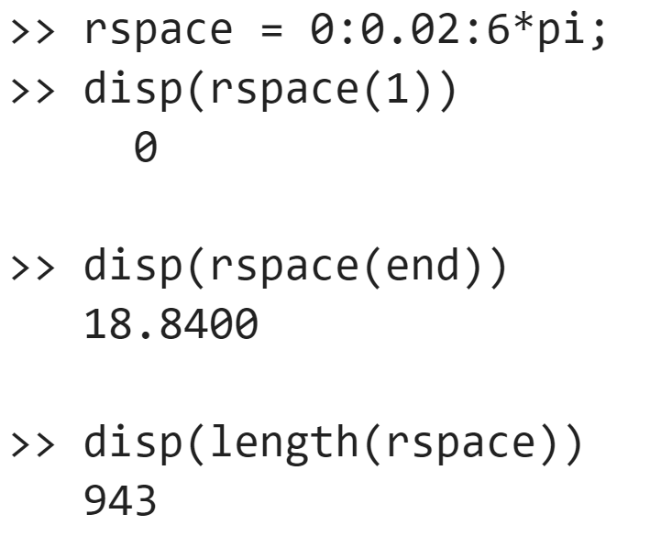

Slide 15
Chapter 4: Arrays, Quick Practice 6
On the command line . . .
. . . Make a “sub-matrix” of Mat. . .
. . . Called SubMat . . .
. . . Made of the first two rows of Mat . . .
. . . And the even columns of Mat

Slide 16
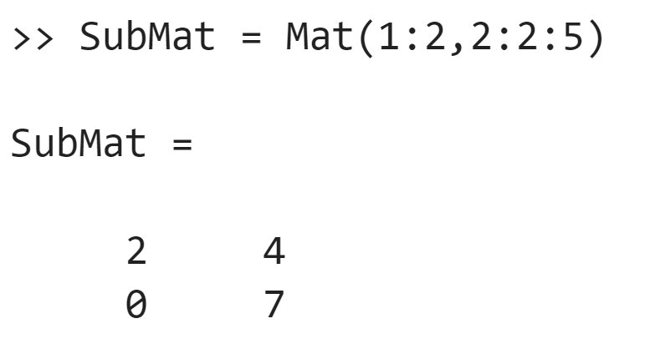
Stopping at “4” is also fine! (Full credit)

Slide 17
Chapter 4: Arrays, Quick Practice 7
On the command line . . .
. . . Store the LAST ROW of SubMat . . .
...as a vector called lastrow

Slide 18
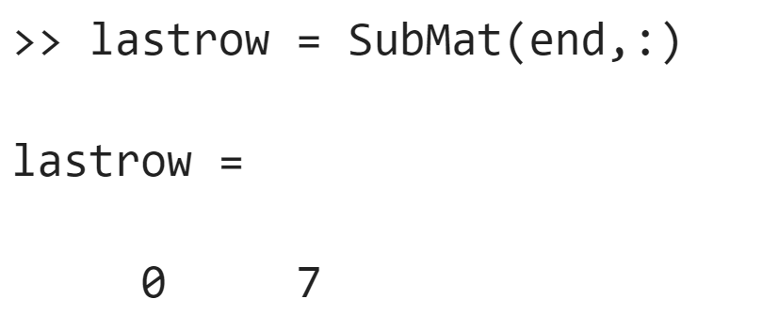
Chapter 4: Arrays, Quick Practice 7
On the command line . . .
. . . Store the LAST ROW of SubMat . . .
...as a vector called lastrow

Slide 19
Chapter 4: Arrays, Quick Practice 8
On the command line . . .
. . . Use a function to find out the number of rows
. . . And the number of columns
. . . Of the matrix Mat
. . . And print out each: “The number of rows is ____”,
“The number of columns is ___”

Slide 20
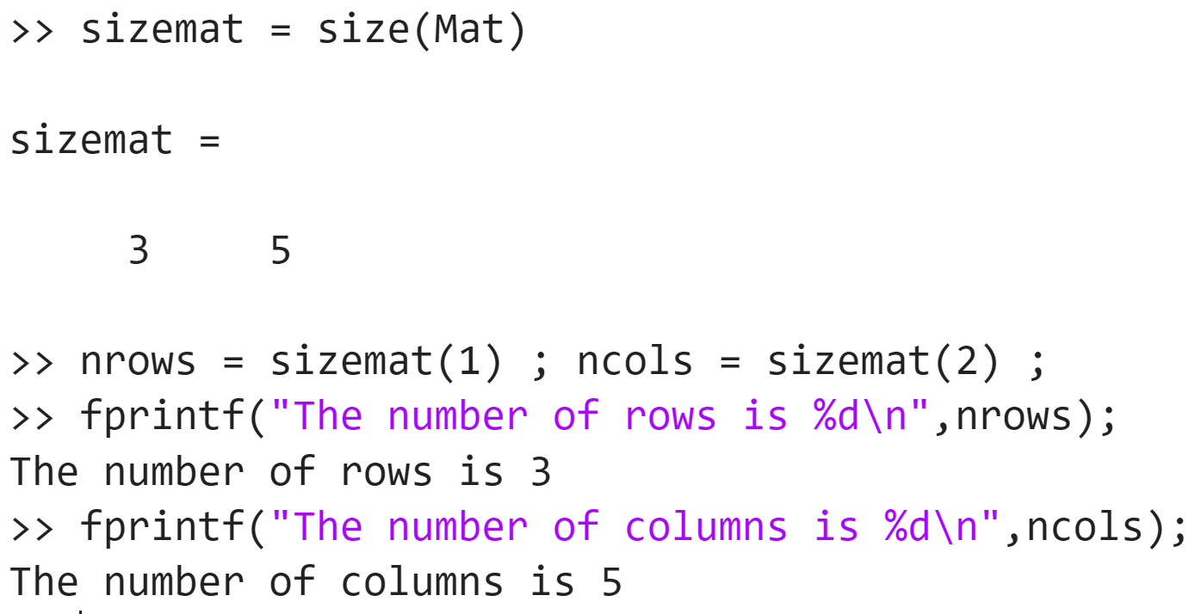

Slide 21
Chapter 4: Arrays, Quick Practice 9
On the command line . . .
. . . Make a new array called vrowrev
. . . By using “:” notation
. . . And has the elements of vrow
. . . But in reverse order!

Slide 22
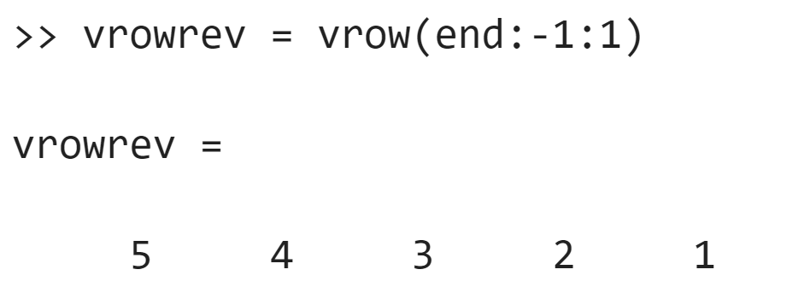

Slide 23
Chapter 4: Plotting, Practice 1
In an m-file called Midterm3PracticePlot1.m
. . . Make a row vector called xvals . . .
. . . Minimum value of 0, maximum value of π
. . .With 100 elements
Evaluate the tangent function for every value of xvals
Evaluate the function x + x³/3 for every value of xvals
And PLOT both of these functions vs. xvals
. . .With different LineShapes, different colors
. . . And limiting the y-axis between -5 and +5
Give the plot a LEGEND,
Label the x-axis “X Values” and the y-axis “Y Values”

Slide 24
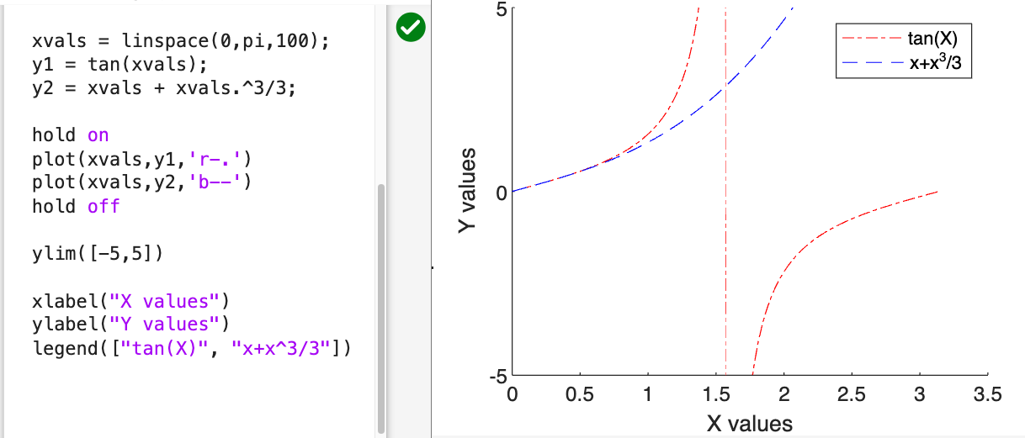

Slide 25
Chapter 4: Plotting, Practice 2
In an m-file called Midterm3PracticePlot2.m
. . . Make a row vector called x . . .
. . . Minimum value of -10, maximum value of +10
. . .With 200 elements
Evaluate the function y1 = exp(-x²/2) for every value of x
Evaluate the function y2 = 1/( 1 + x²) for every value of x
And PLOT both of these functions vs. xvals
. . .With different LineShapes, different colors
. . . And limiting the y-axis between 0 and 1.1*max value between y1 and y2
Give the plot a LEGEND,
Label the x-axis “X Values” and the y-axis “Y Values”

Slide 26
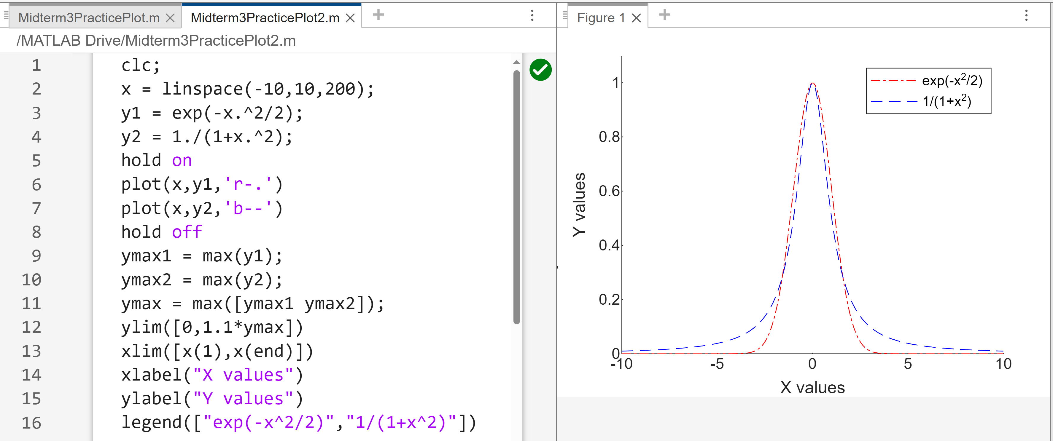

Slide 27
Chapter 5: Functions and Subfunctions, Practice 1
Write an m-file named ReverseRows.m
That has a function called ReverseRows
Which takes as input, in general, a matrix A
And produces as its output a matrix B . . .
Where each row of B is the reverse of the corresponding row in A
USE A SUBFUNCTION to reverse the rows of A individually

Slide 28
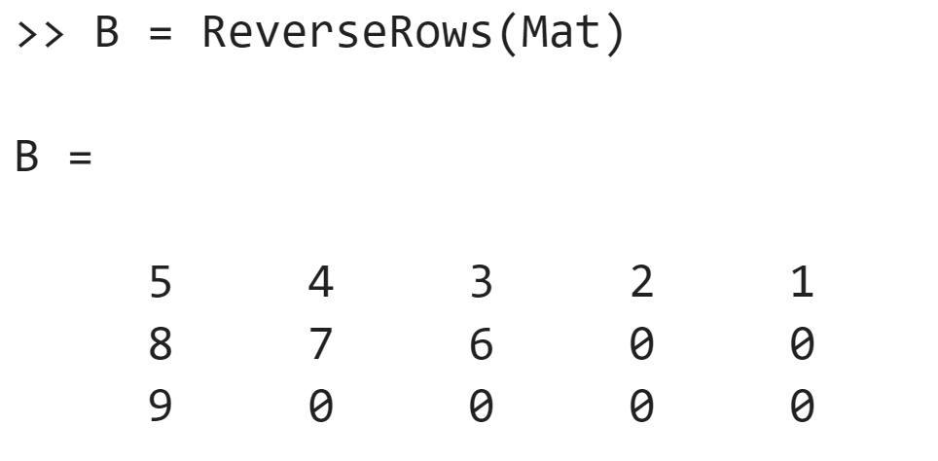
Chapter 5: Functions and Subfunctions, Practice 1, Test case

Slide 29
